Slide 1
Horizon X2A DDR4 PCB SIPI review
Confidential for Horizon
SNPS SIPI team
April 2, 2020

Slide 3
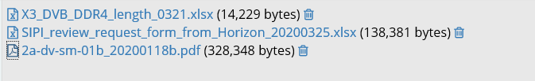
Input for SIPI review
PCB layout .brd
PCB schematics
Length report

Slide 4
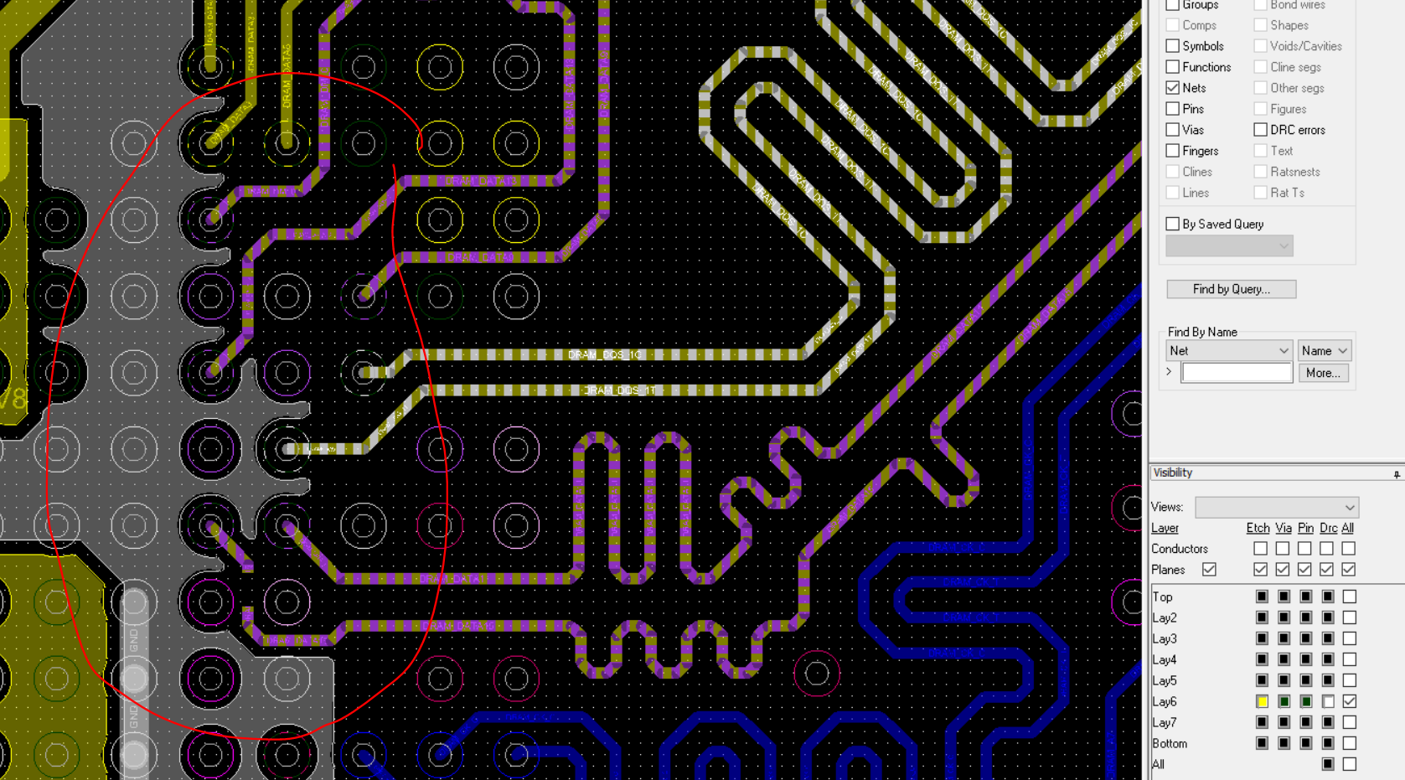
BGA signal to GND ratio
This is mentioned in our package review. Very few reference BGA pads in signal pin field, resulting in via crosstalk for signals routed close to bottom with long vias. Validate with SI simulation

Slide 5
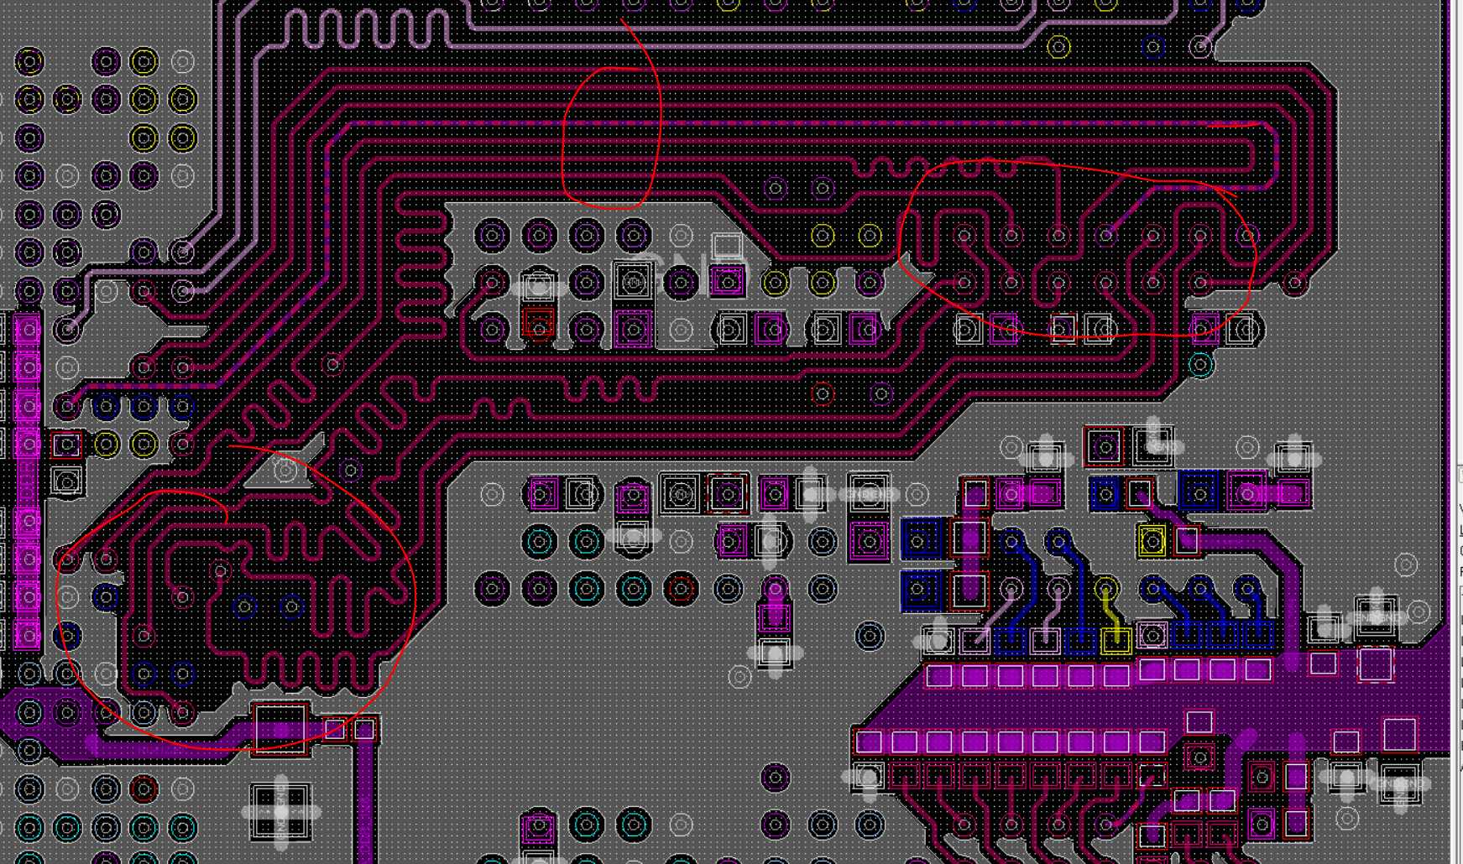
CMD lane routing
CMD lane routine on bottom layer has concerns of microstrip crosstalk
Same via cross talk concerns in SOC and RAM pin field due to lack of reference vias.
wider trace and lower impedance from SOC to first DRAM may help with reflection/ringback.
Validate above with simulation

Slide 6
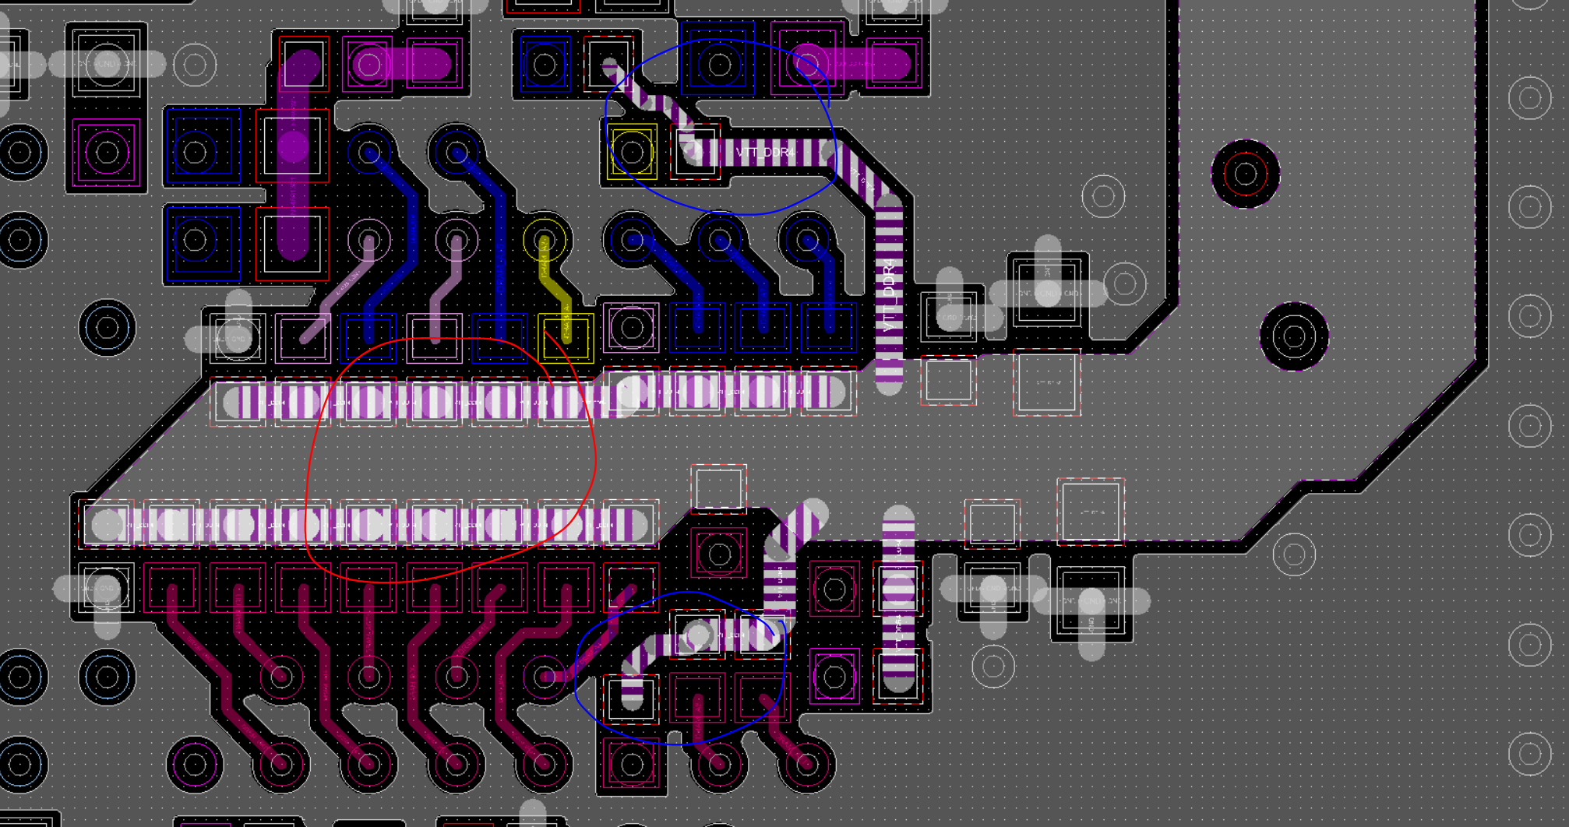
VTT termination for CMD
Improve VTT decap distribution in signal field
Check long VTT trace connection impact on termination

Slide 7
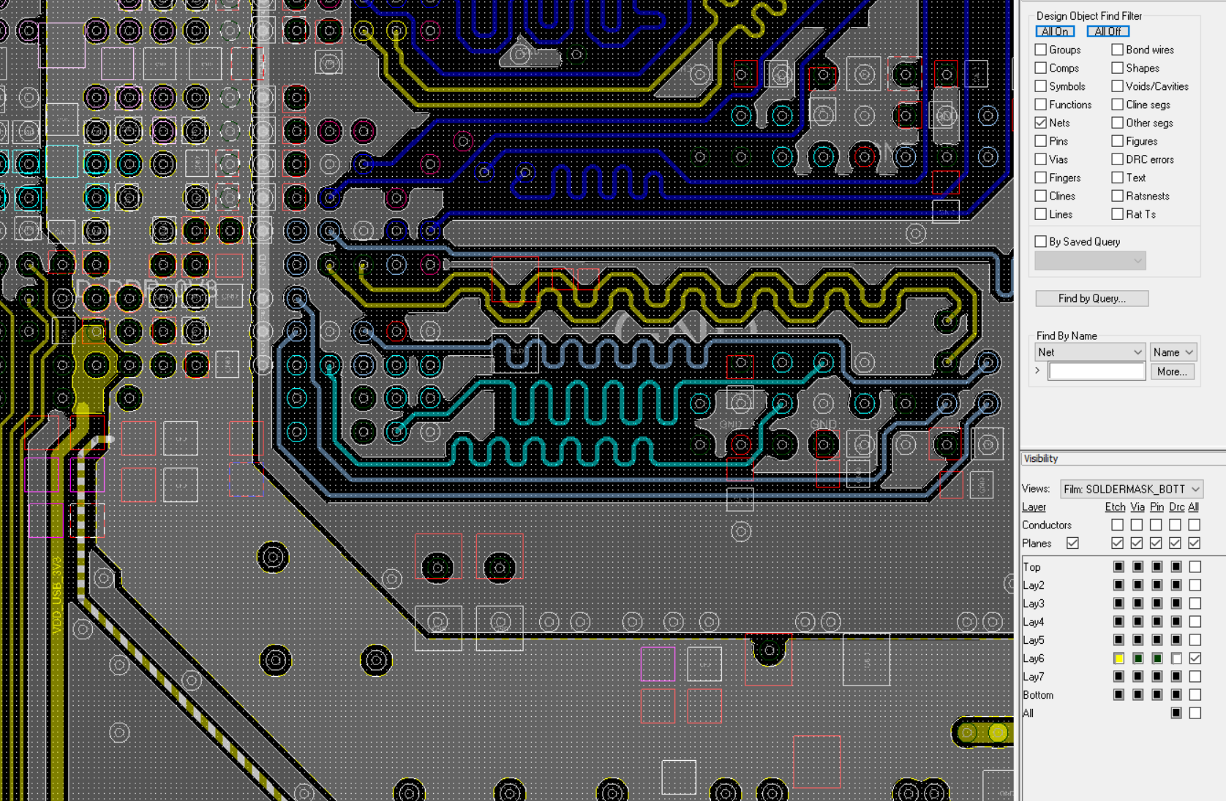
Core VDD PDN
High inductance due to lack of power pins on BGA, and long vias. Will affect VDD ripple.
IR concern due to via antipad on layer 6 and webbing.

Slide 8
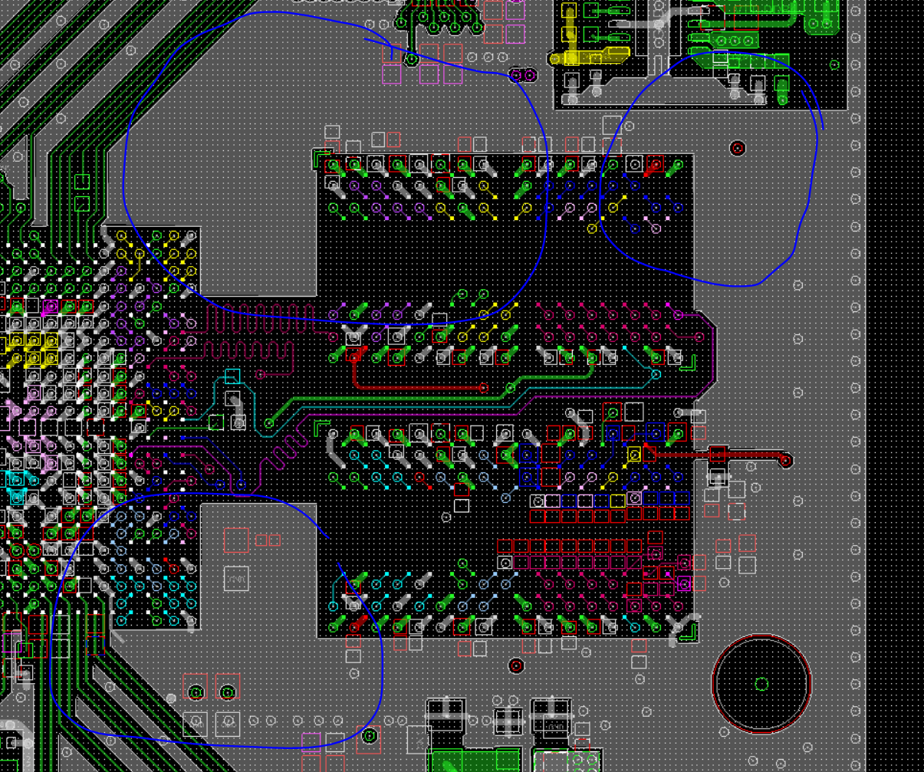
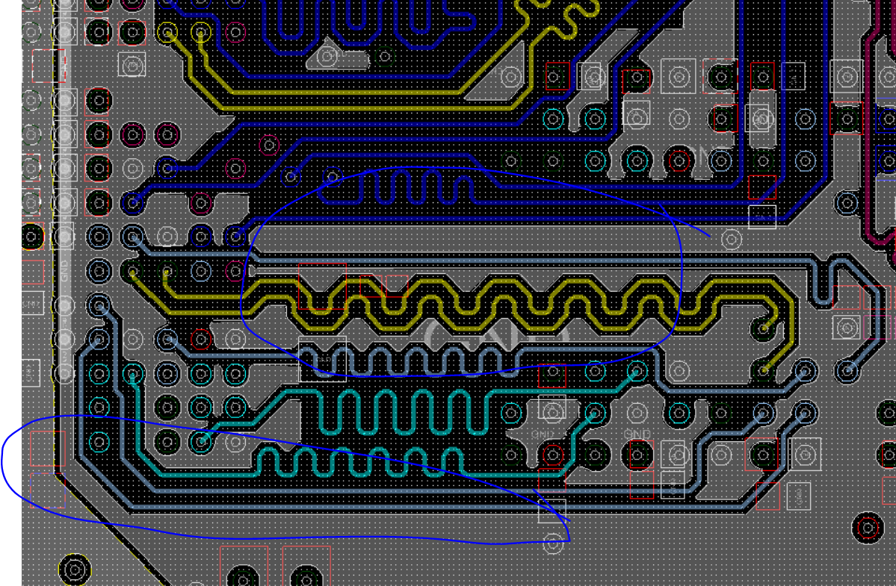
Ground flood/guard trace stitching
It’s a good idea to have stitching vias on flood/guard trace, otherwise consider removing them as it can do more harm than good.

